Slide 1
E-BOOK MANAGEMENT SYSTEM
Presented By
191FA04046,
191FA04064,
191FA04073,
191FA04576.

Slide 2


E-BOOK MANAGEMENT SYSTEM
Under Guidance of:
Mr. M Narendra
Assistant Professor, CSE
Mr. M Veerabrahmam
Assistant Professor, CSE
Presented By: Sk.Shafiulla(191FA04046) A.Tejeeswar(191FA04064) D.Venu(191FA04073) T.V.Gowtam(191FA04576)
Department of Computer Science and Engineering
VFSTR Deemed to Be University

Slide 3
INDEX
Introduction
Problem Statement
Software Requirements
Hardware Requirements
Function Requirements
Screenshots
Conclusion

Slide 4
Problem Statement: These days number of students are getting increased and there is a situation where each and every student can’t able to access the books from library and some are not able to buy those books.
INTRODUCTION

Slide 5
Project Background: This project is about creating the database for maintain the details of the student who are taking books and when they are taking the books? Here the task is to include all information of student and the books he/she taken and when they had returned? In this, first student has to register then the student needs to enter the information of what books the student is taking and that information will be stored in the database. The back end process is completed by creating the necessary tables in the database. Then we need to connect the back end to front end part i.e. database must be connected to the java part.

Slide 6
Software Requirements:
JDK 15 NETBEANS IDE 12.1 LTS MYSQL USING XAMPP WEB SERVER

Slide 7
Hardware Requirements:
MEMORY: 4GB DISK SPACE: 126 MB PROCESSOR: MINIMUM PENTIUM 2266 MH_{Z} PROCESSOR

Slide 8
Function Requirements:
Admin and user (Students) should be able to: view the data(tables) update the data(tables) Admin can able to add or remove the students. Database should be updated if student details have been changed and display the updated values.

Slide 9
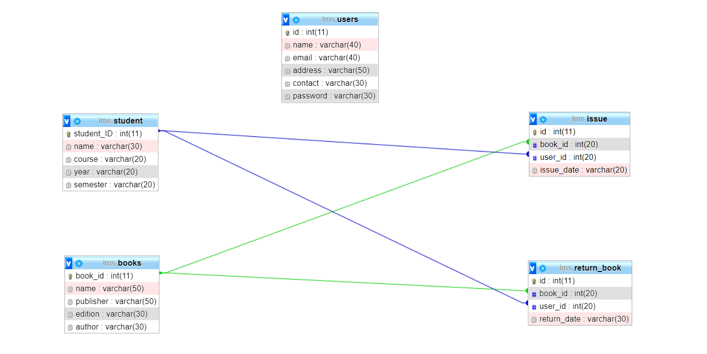
Database Schema:

Slide 10
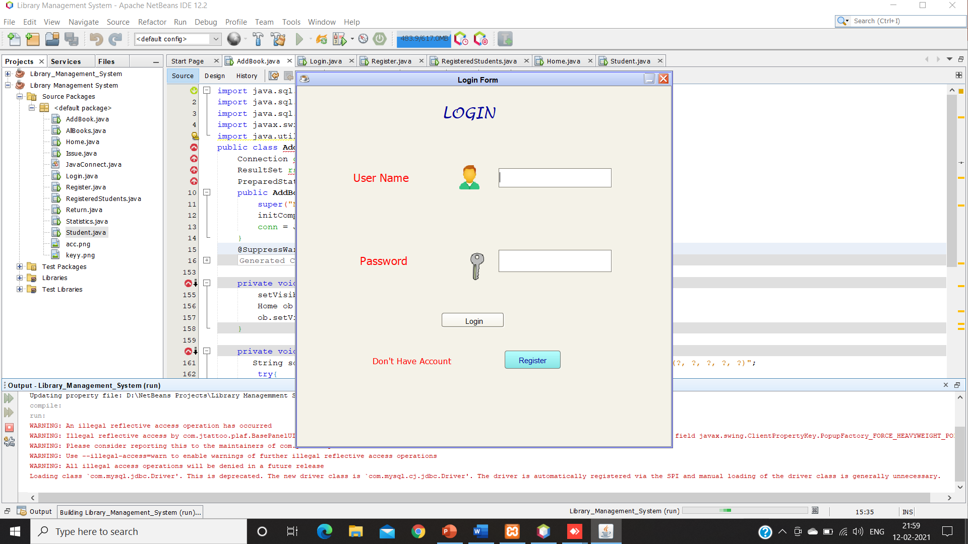
Screenshots:
Login Frame:

Slide 11
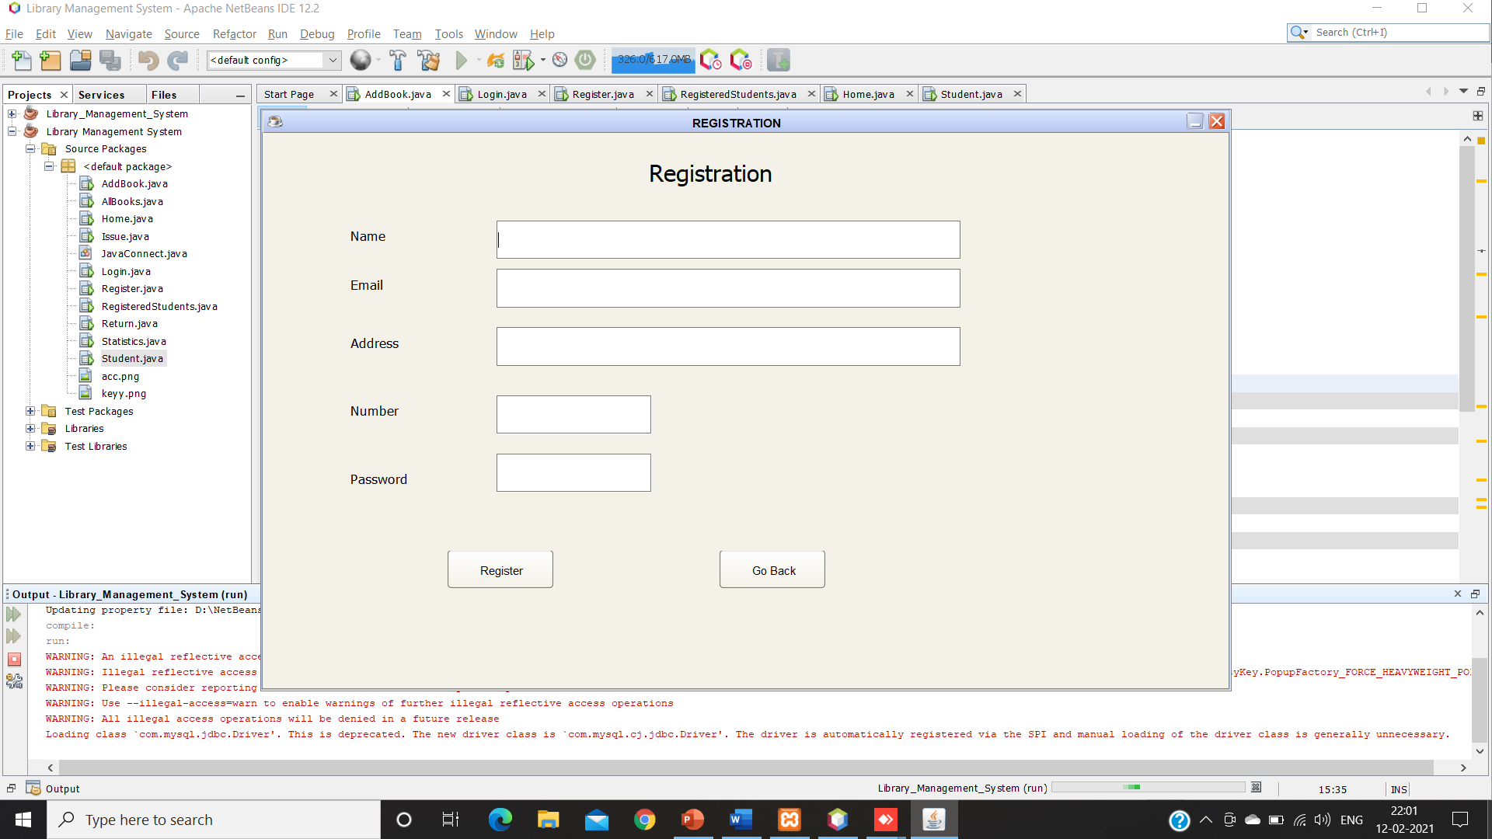
Registration Frame:

Slide 12
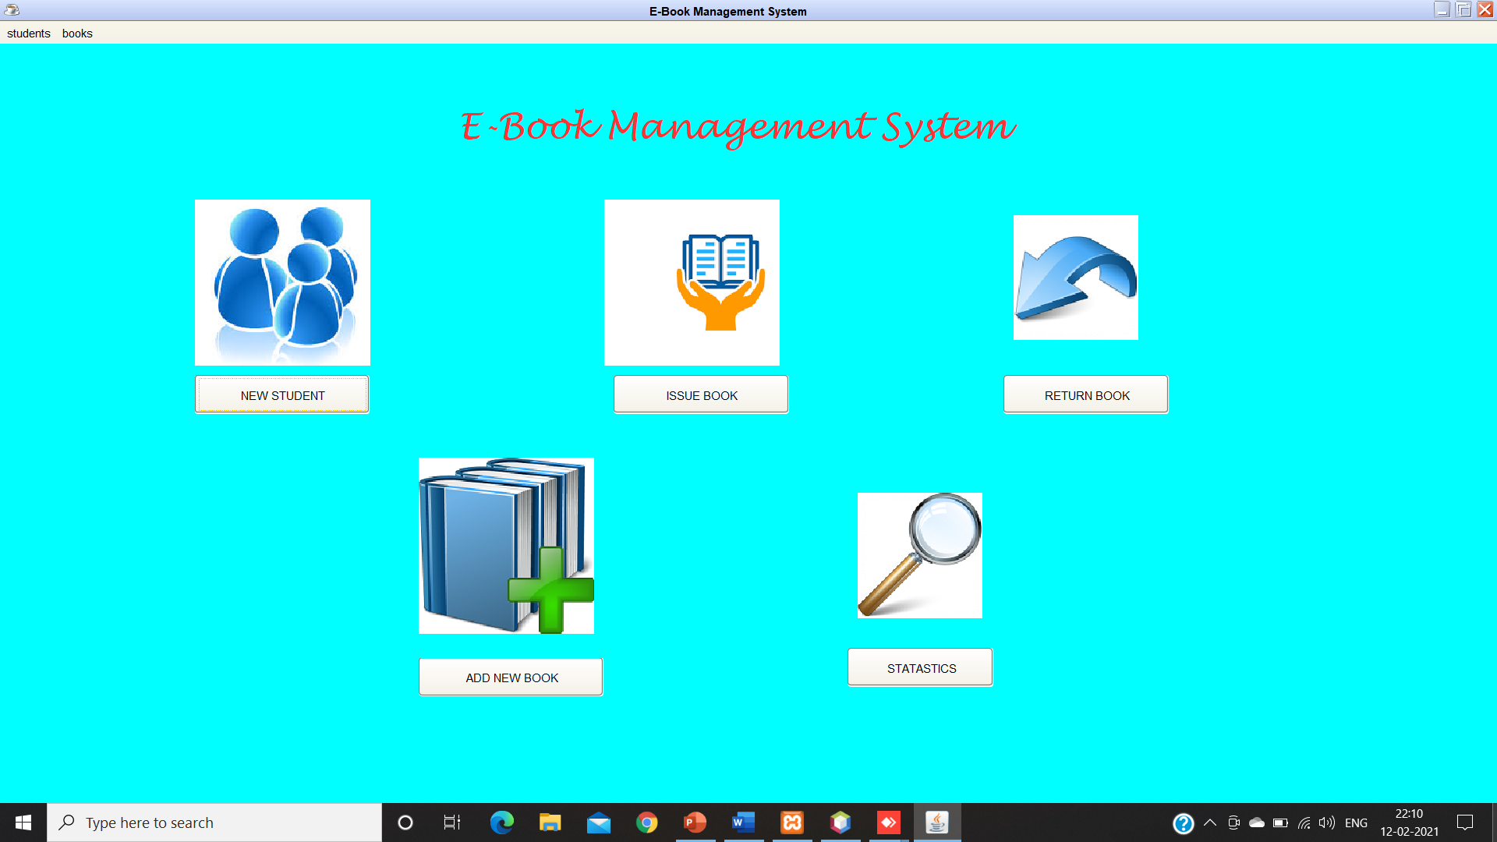
After Logging in(Dashboard):

Slide 13
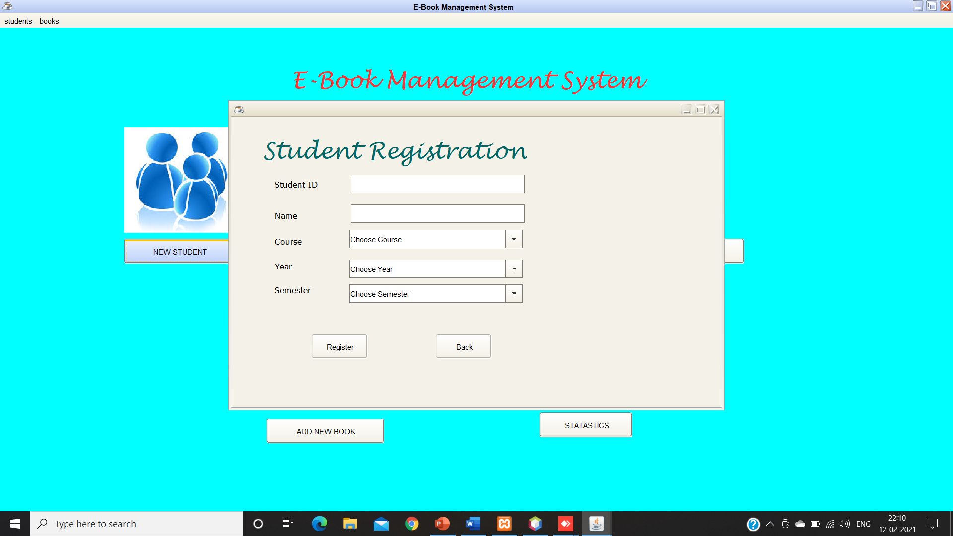
New Student Registration:

Slide 14
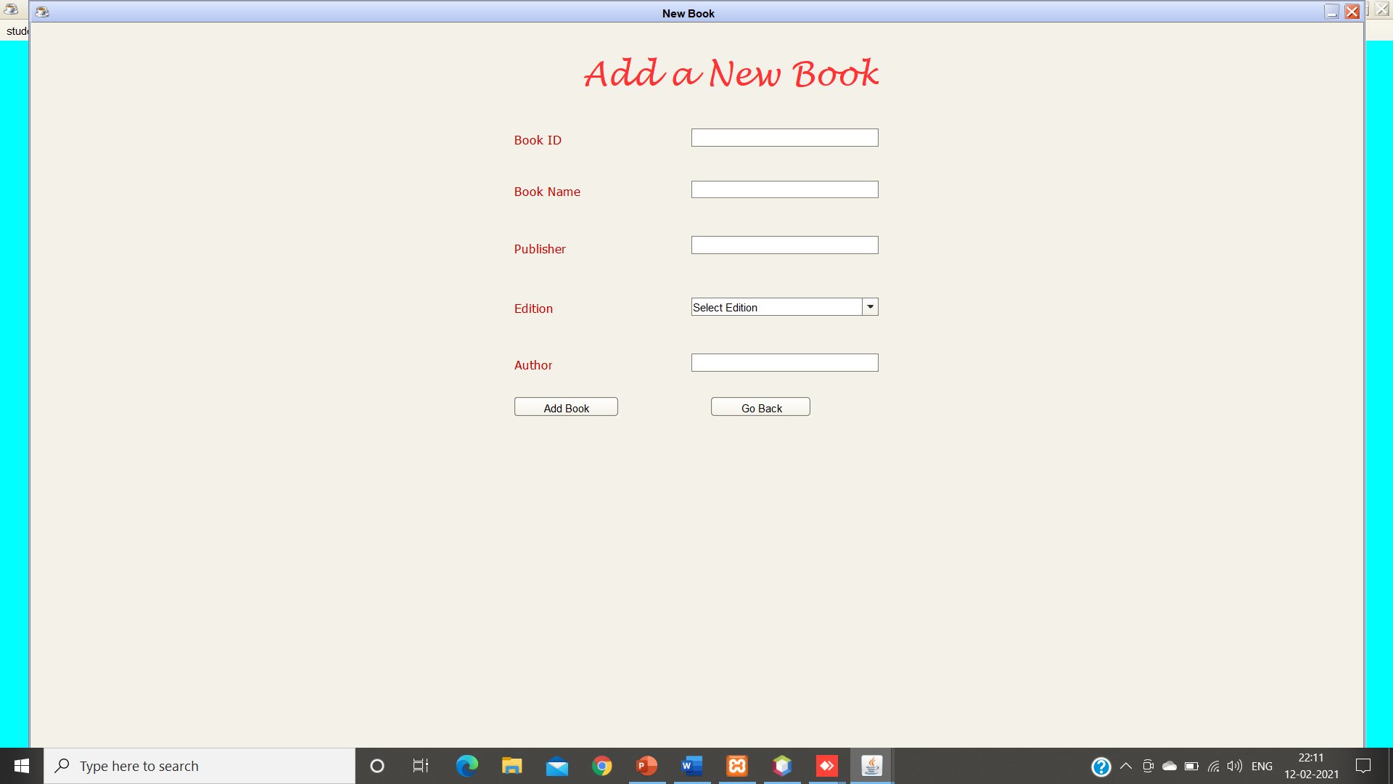
Adding New Book:

Slide 15
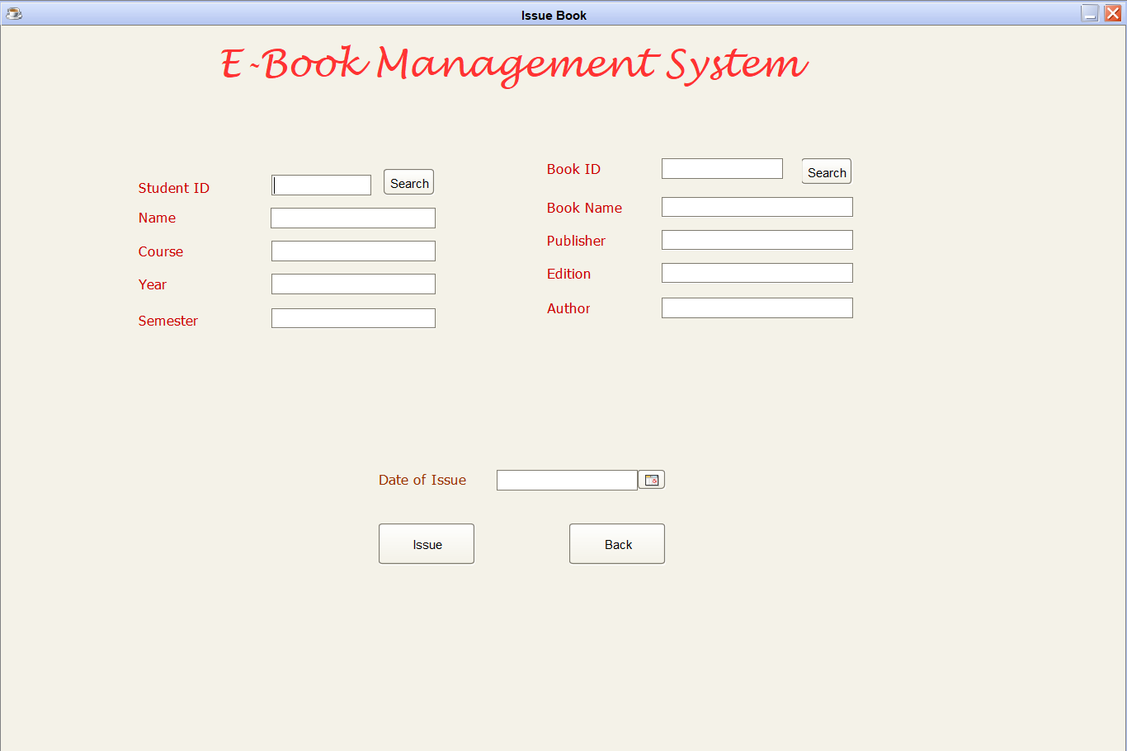
Issue Book:

Slide 16
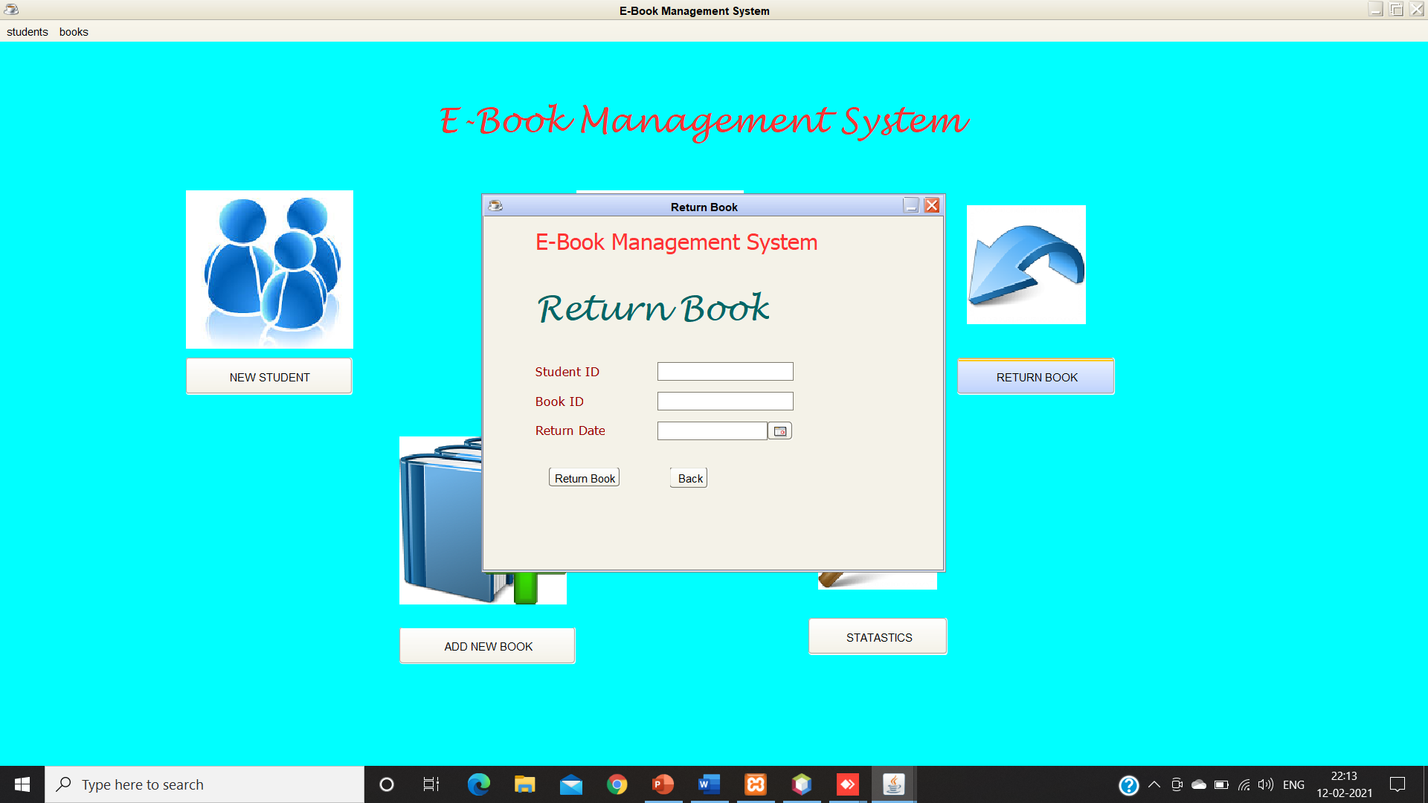
Return Book:

Slide 17
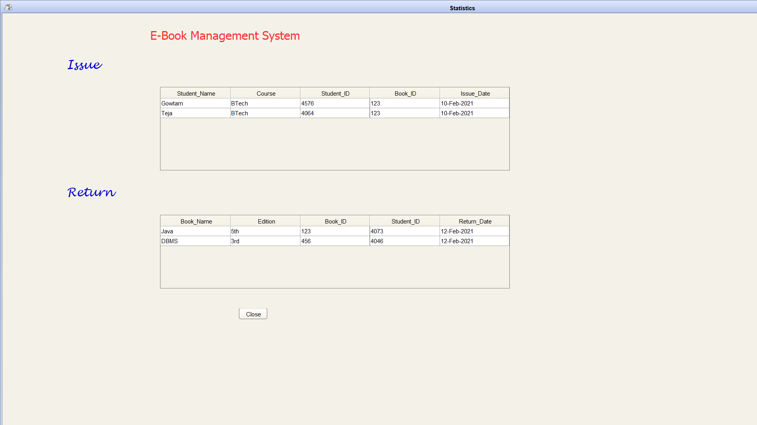
Statistics:

Slide 18
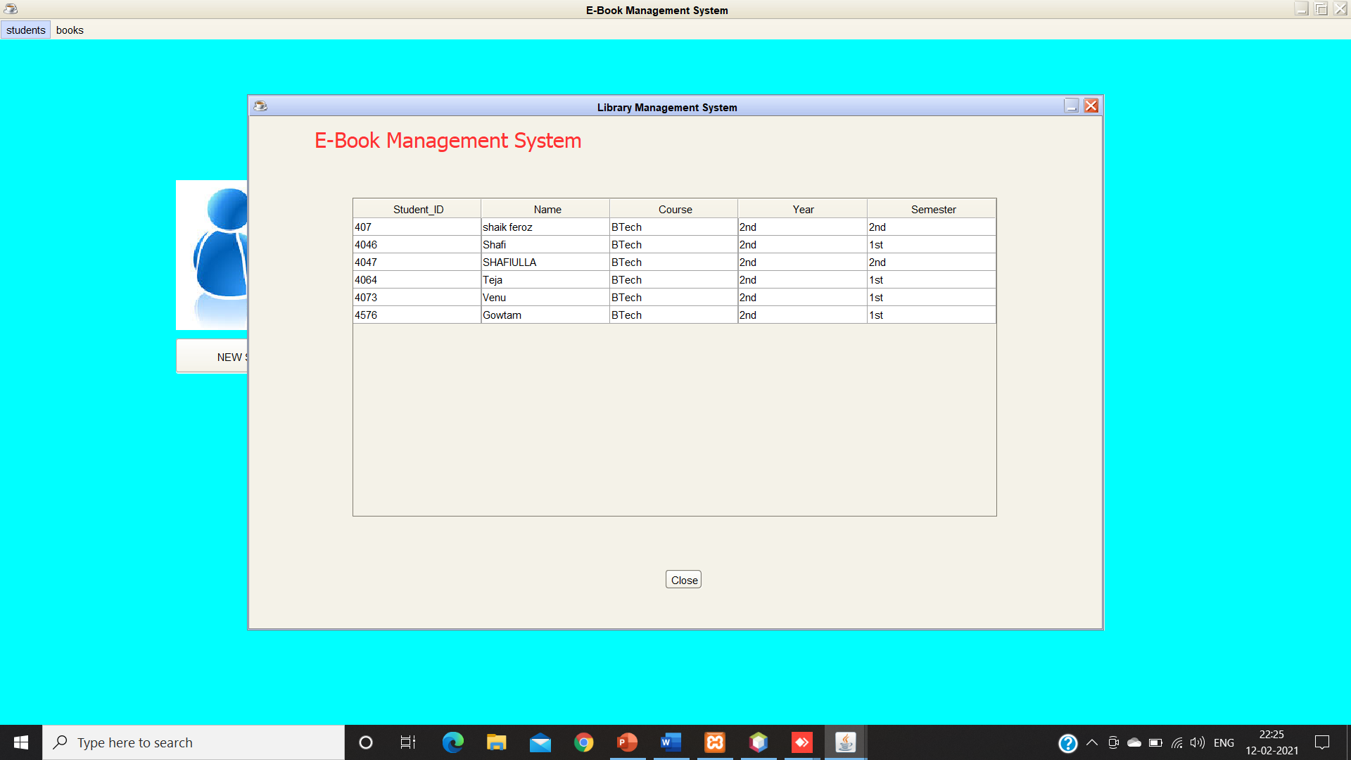
List of Registered Students:

Slide 19
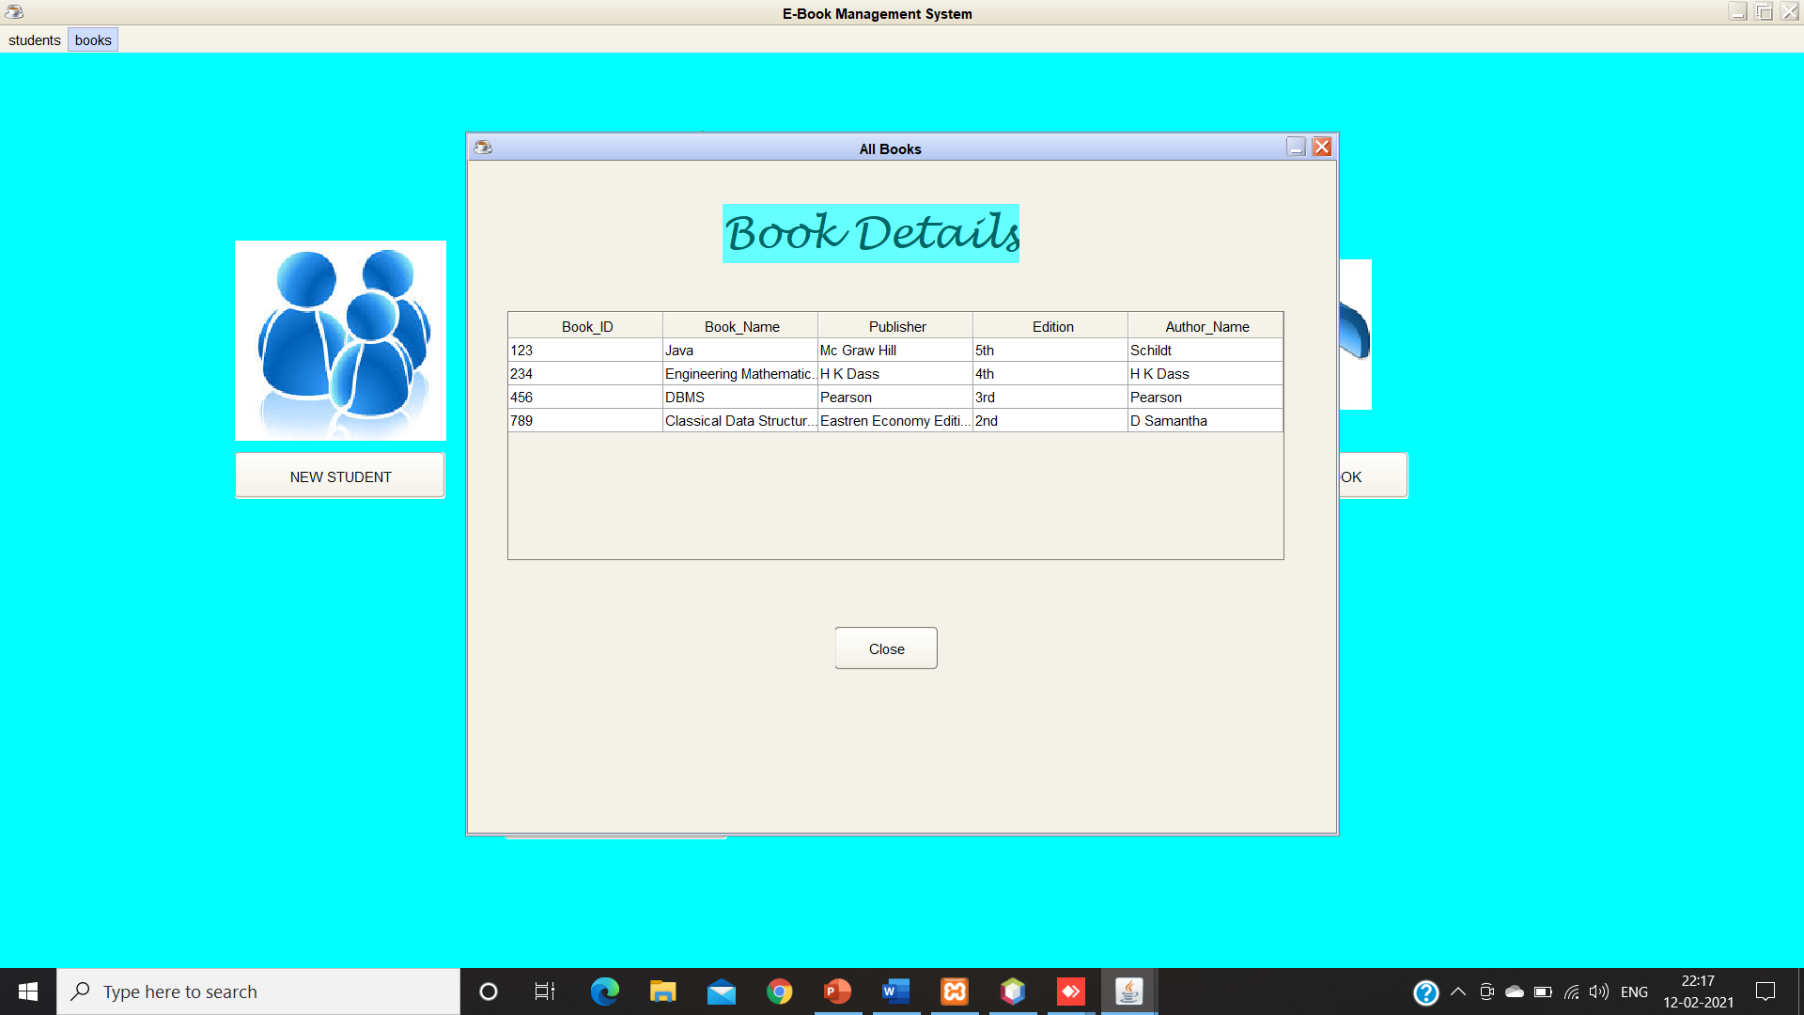
List of Books:

Slide 20
Conclusion:
Thus we can able to manage the information related to books and students who are accessing them. Thus the project for E-BOOK MANAGEMENT has been successfully executed and codes are generated.

